Slide 1
WaveCRN: An Efficient Convolutional Recurrent Neural Network for End-to-end Speech Enhancement
Presenter: Tsun-An Hsieh
Date: 2020/07/08

Slide 2
Outlines
A Brief Introduction of SE systems
CNN, RNN, and CRN
Experiments – Denoising
Experiments – Compressed Speech Restoration
Conclusions, Q&A

Slide 3
SE pipelines
Log power spectrum based
Raw waveform based
Source: Speech enhancement with stacked frames and deep neural network for VoIP applications

Slide 4
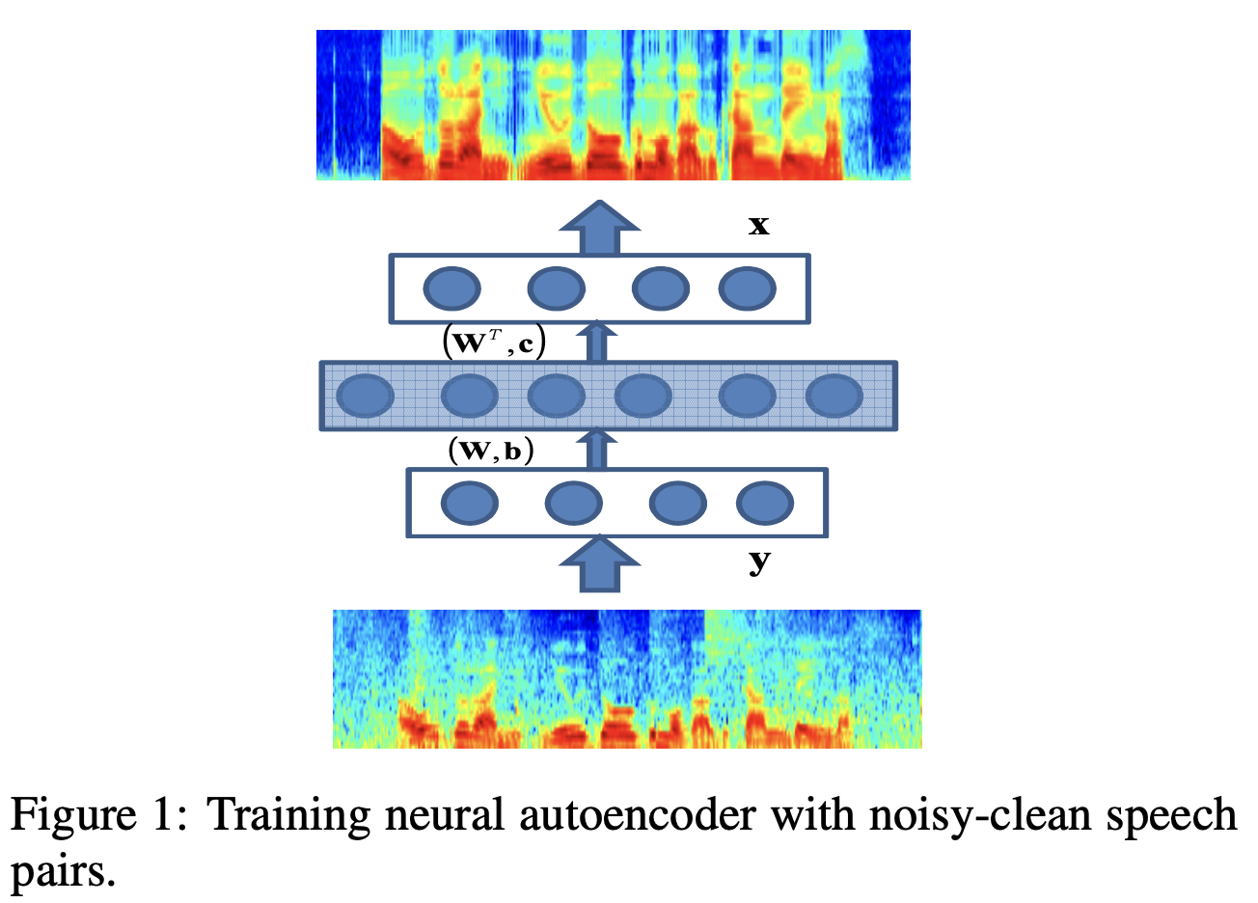
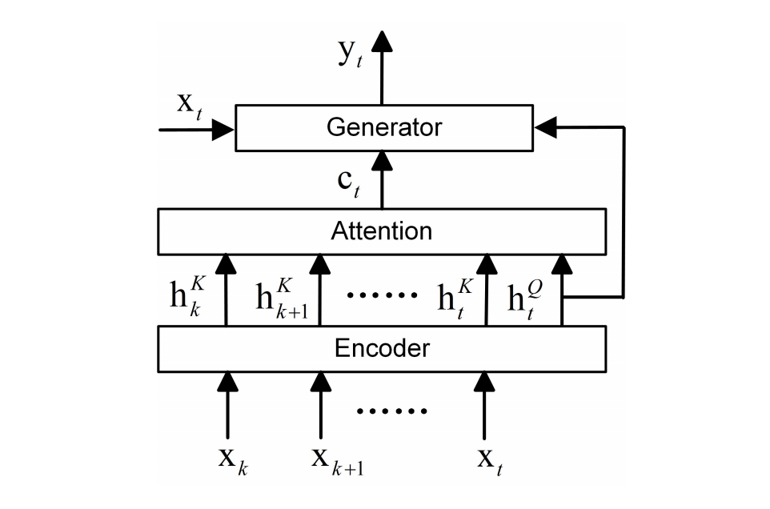
Log Power Spectrum Based Methods
Deep Denoising Auto-Encoder
AN ATTENTION-BASED NEURAL NETWORK APPROACH FOR SINGLE CHANNEL SPEECH ENHANCEMENT
https://www.citi.sinica.edu.tw/papers/yu.tsao/3582-F.pdf
http://www.nwpu-aslp.org/lxie/papers/2019ICASSP-XiangHao.pdf

Slide 5
Log Power Spectrum Based Methods
Using noisy phase spectrum in reconstruction decreases the quality of the enhanced speech.
Alternatives:
Raw waveform based model
Complex masking

Slide 6
Outlines
A Brief Introduction of SE systems
CNN, RNN, and CRN
Experiments – Denoising
Experiments – Compressed Speech Restoration
Conclusions, Q&A

Slide 7
Convolutional Recurrent Neural Network
CNNs capture better local information, while miss the ordering of features.
RNNs encode sequence by computing similarity recurrently. However, most of RNNs (e.g. LSTM, GRU) have time consumption issues.
To leverage both types of models, some approaches combined CNNs and RNNs as SE systems.
Source: https://www.websystemer.no/beyond-cnn-a-brief-intro-of-capsule-network/

Slide 8
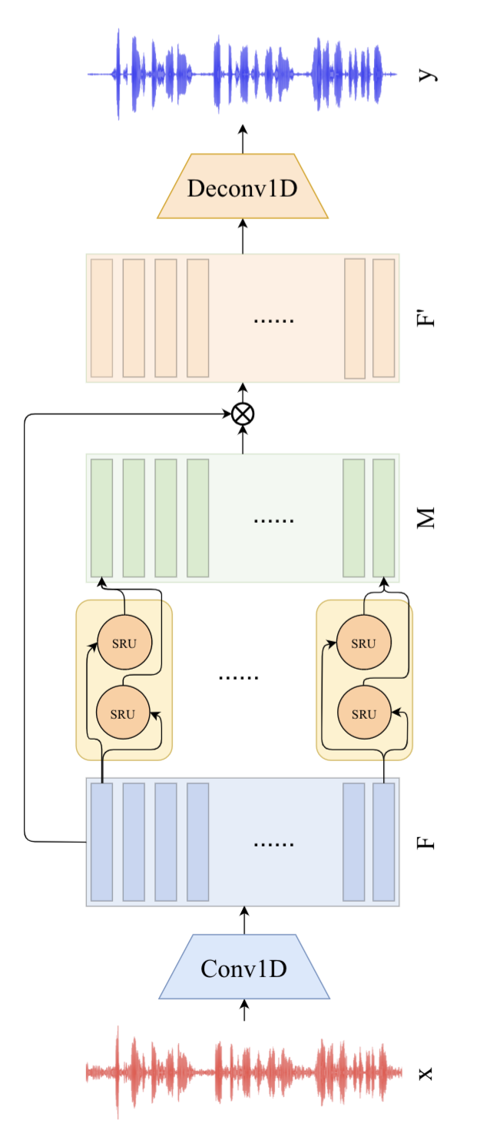
WaveCRN
Encodes time domain signals x into feature map F.
Using SRU instead of LSTM for faster sequence modeling.
Estimates a mask M (RFM) and applied it to F, resulting a enhanced feature map F’.
Deconvolution.

Slide 9
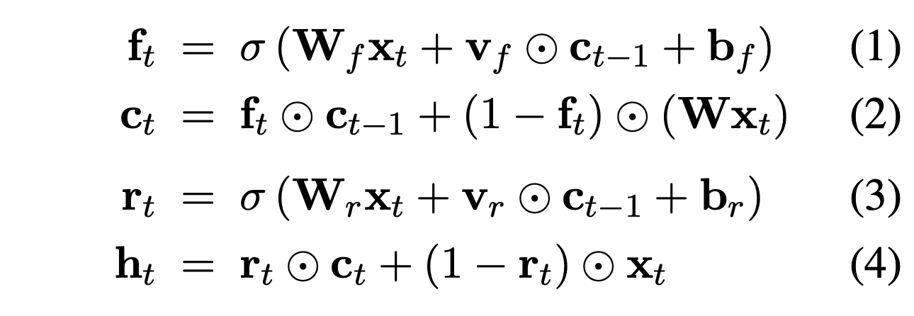
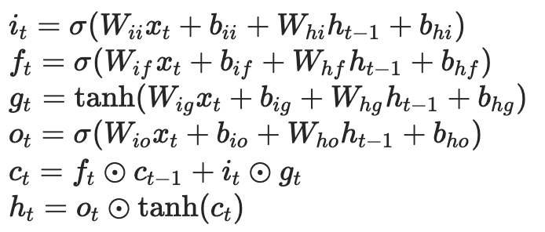
SRU vs. LSTM
SRU:
(1), (2): light recurrence (less gate dependency)
(3), (4): highway network
Hadamard product is faster than matrix multiplication.
LSTM:

Slide 10
Outlines
A Brief Introduction of SE systems
CNN, RNN, and CRN
Experiments – Denoising
Experiments – Compressed Speech Restoration
Conclusions, Q&A

Slide 11
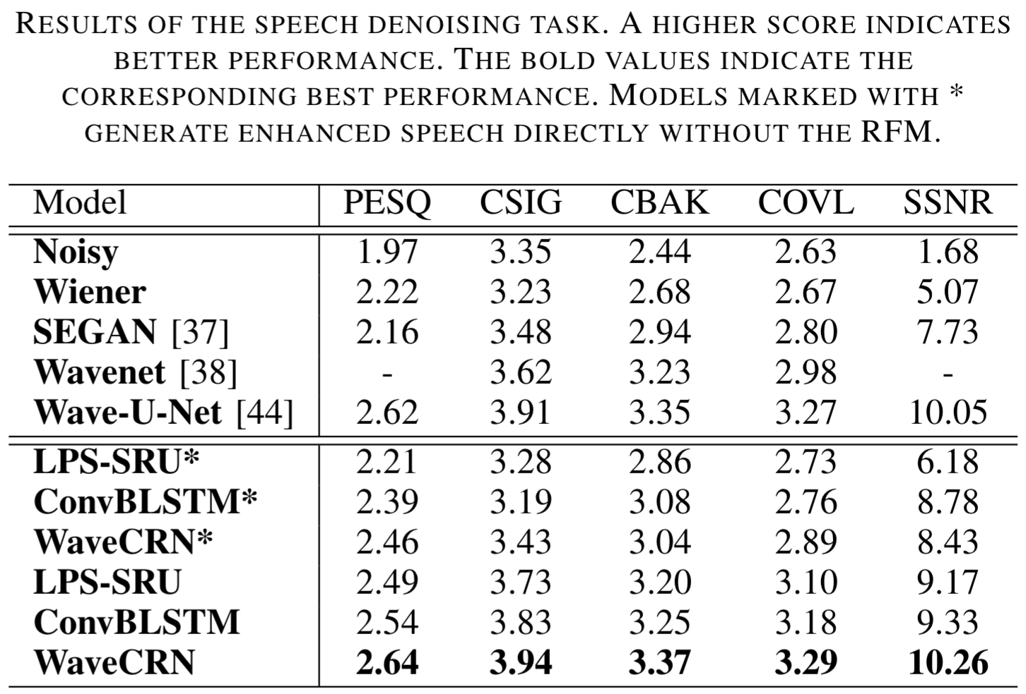
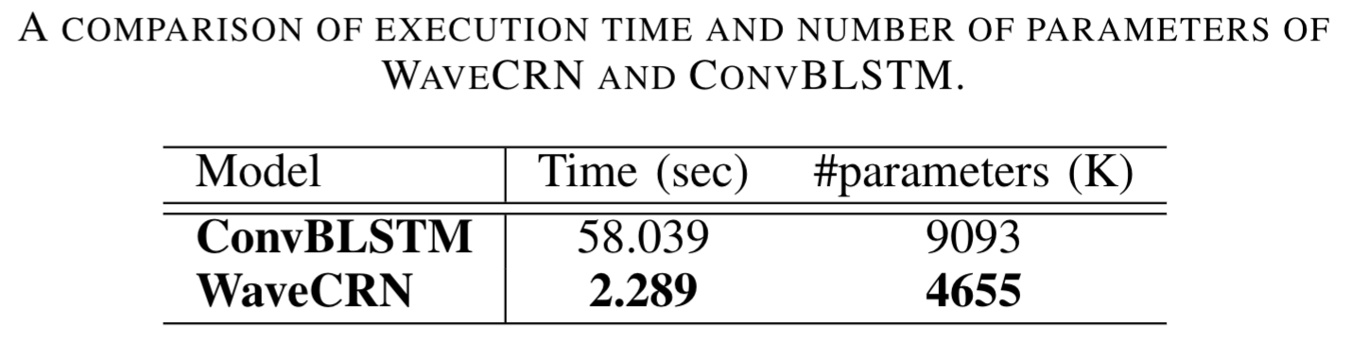
Denoising
PESQ: perceptual speech quality
CSIG: signal distortion mean opinion score
CBAK: background intrusiveness
COVL: overall speech quality
SSNR: segmental SNR

Slide 12
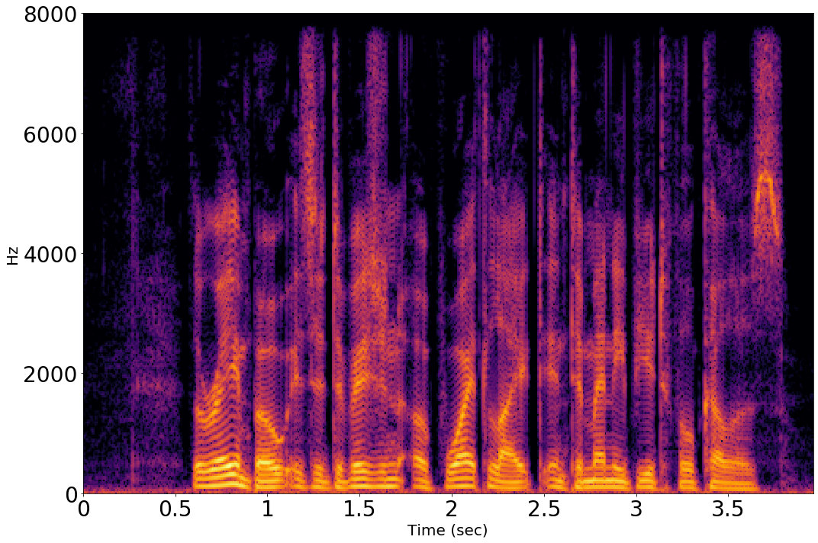
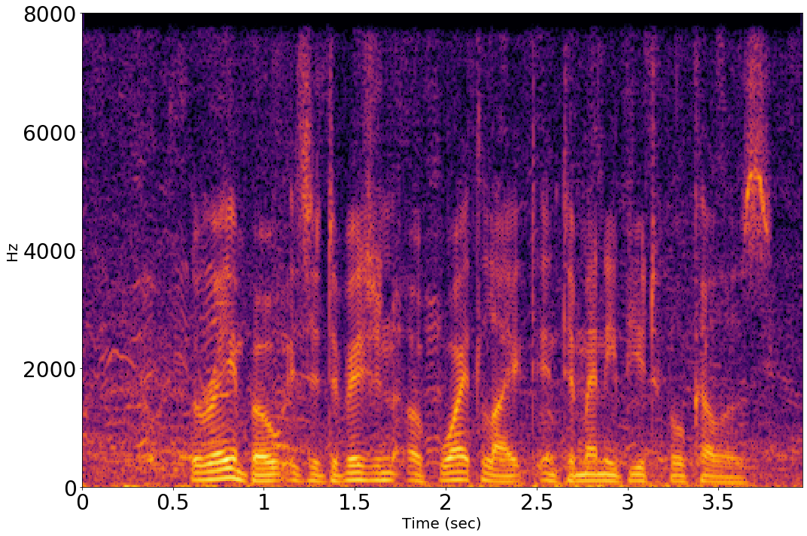
Denoising
clean
noisy

Slide 13
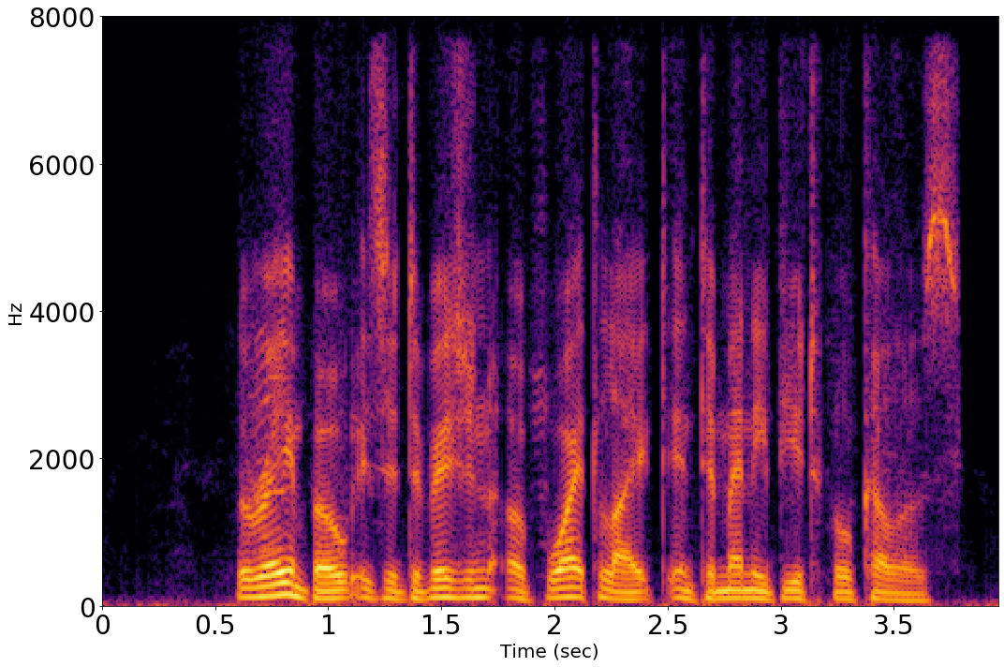
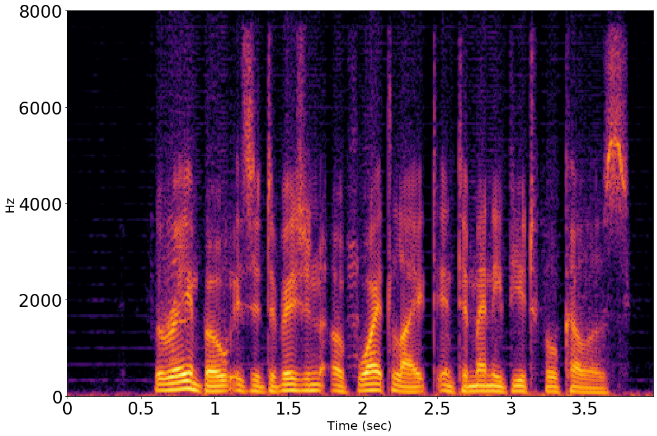

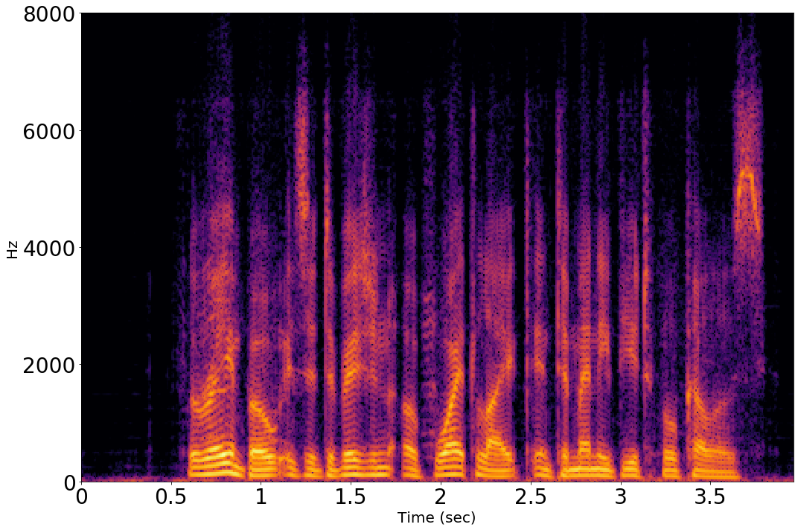
with mask
without mask
WaveCRN
ConvBLSTM

Slide 14
Outlines
A Brief Introduction of SE systems
CNN, RNN, and CRN
Experiments – Denoising
Experiments – Compressed Speech Restoration
Conclusions, Q&A

Slide 15
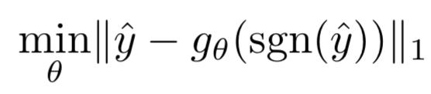
Compressed Speech Restoration
For each input signal, its magnitude is quantized to -1, 0, and +1.
16-bit => 2-bit
A WaveCRN aims to derive the original speech before being compressed.
All hyperparameters are identical to denoising task.

Slide 16
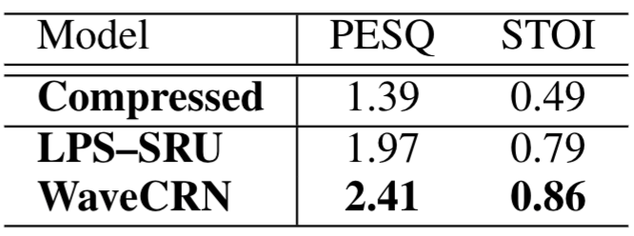
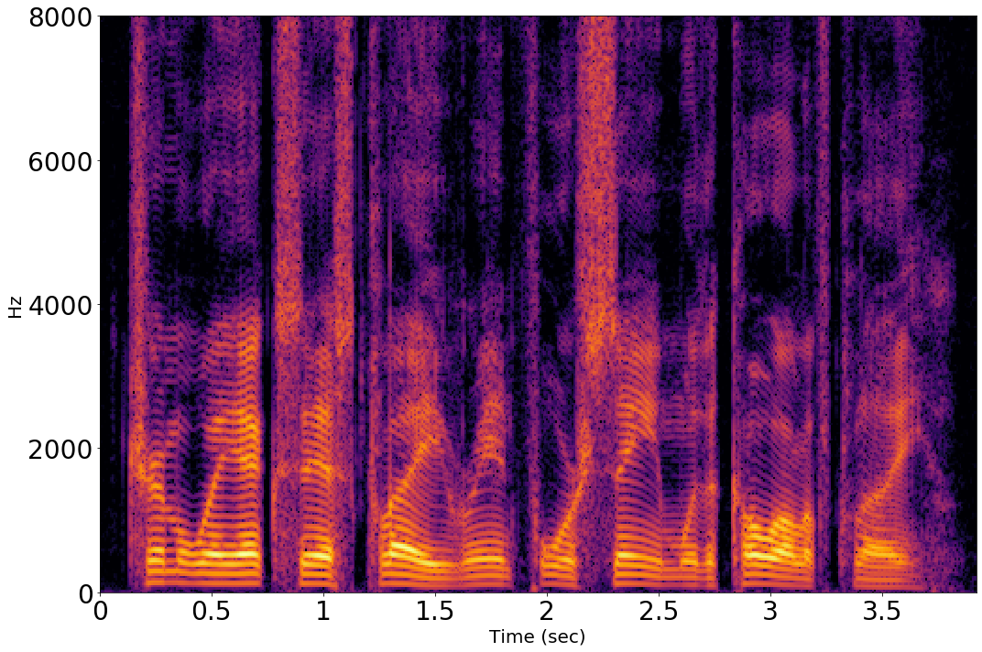
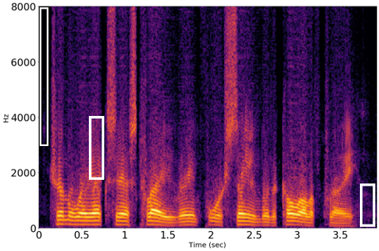
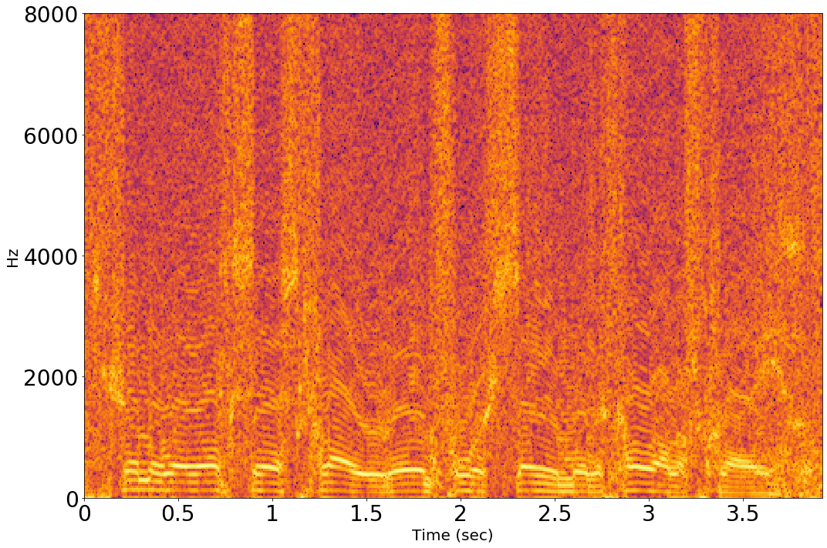

Compressed Speech Restoration
clean
WaveCRN
noisy
LPS-SRU

Slide 17
Outlines
A Brief Introduction of SE systems
CNN, RNN, and CRN
Experiments – Denoising
Experiments – Compressed Speech Restoration
Conclusions, Q&A

Slide 18
Conclusion
Integrate SRU into previous CRN, getting better performance on quality and computational efficiency (25.36x faster than ConvBLSTM)
Less parameters, better generalization.
RFM highly improved the performance. A masked LPS based method is even better than unmasked WaveCRN.
Comparing to SEGAN, Deep Feature Losses, and some other approaches, WaveCRN is competitive with much simpler structure.
Designed a new application (e.g. compressed speech restoration) and get promising results.

Slide 19
Q&A

